Slide 1
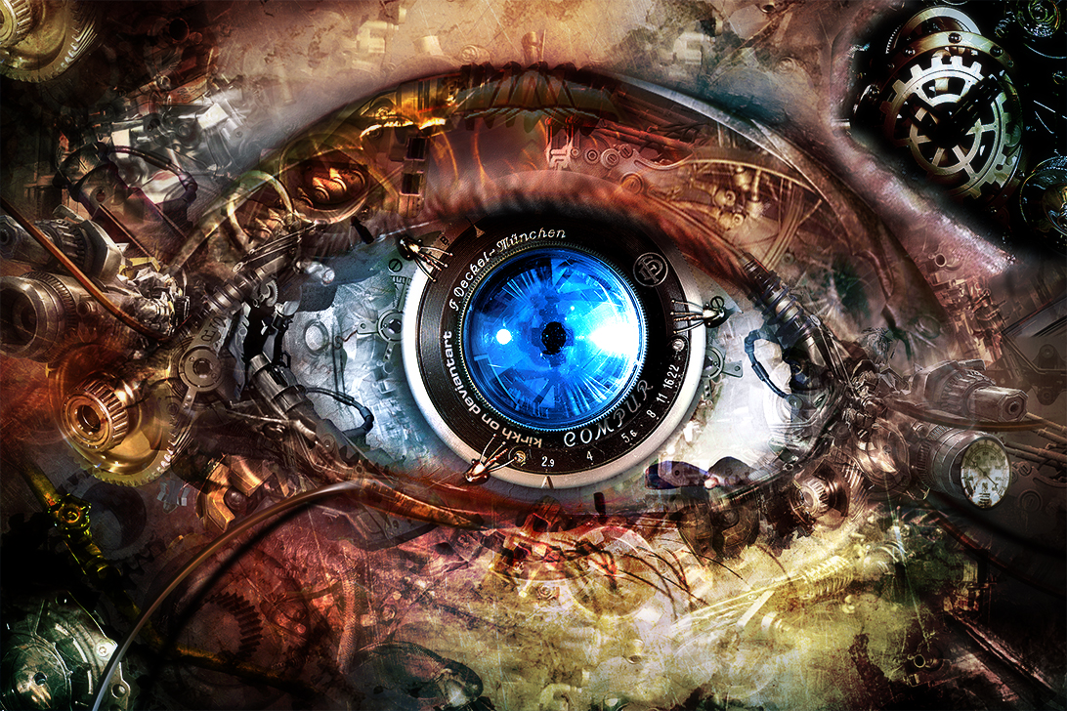
Introduction to Computer Vision
Image by kirkh.deviantart.com

Slide 2
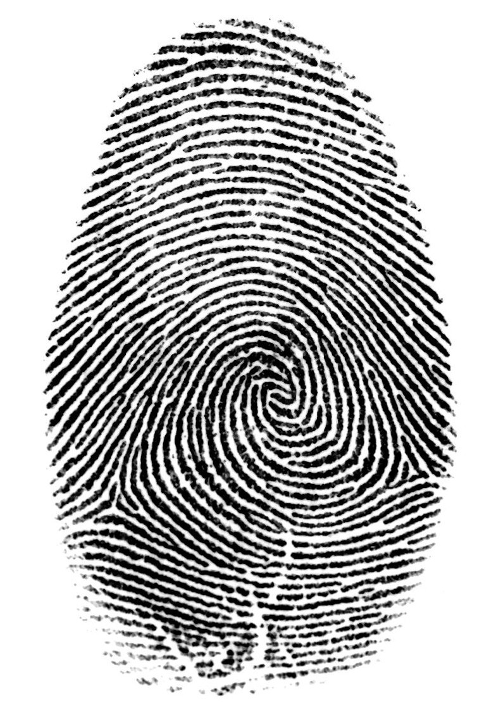
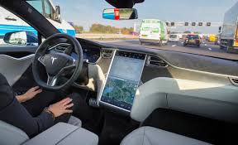
Computer Vision in Our Living
指纹识别
无人驾驶
OCR（Optical Character Recognition）

Slide 3

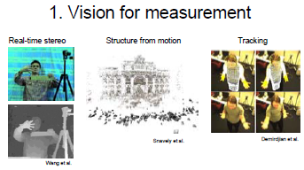
What is Computer Vision?

Slide 4
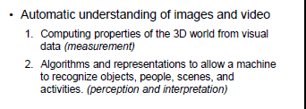

Slide 5
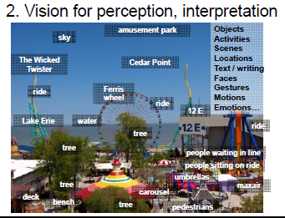

Slide 6
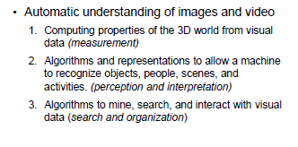

Slide 7
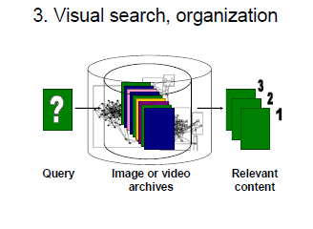

Slide 8
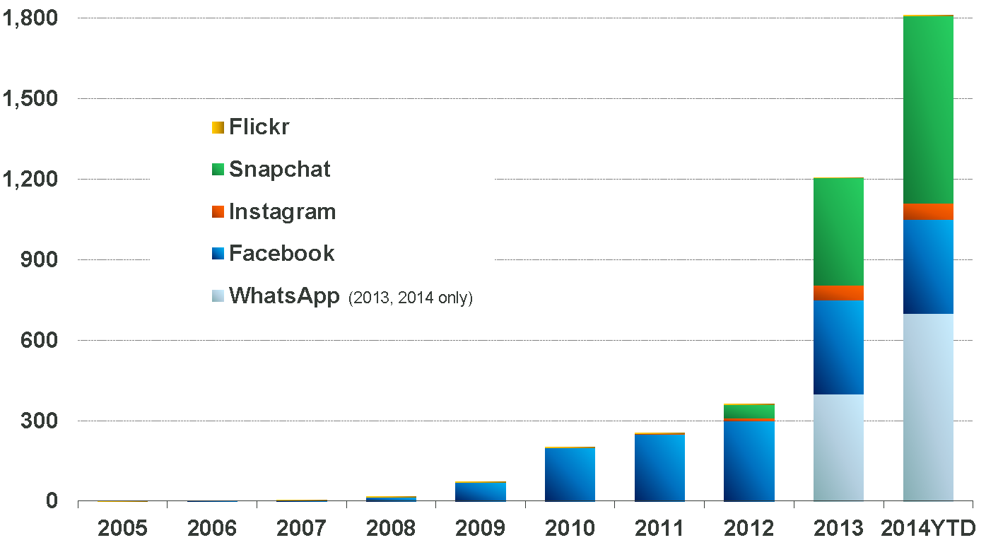
Explosive growth of Image and video data

Slide 9
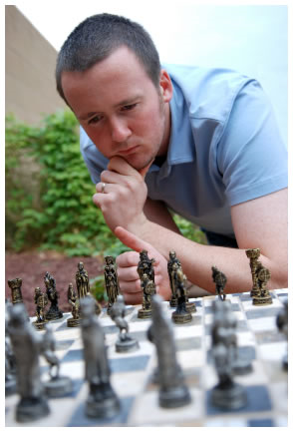
Vision is really hard
Vision is an amazing feat of natural intelligence
--80% perceptions are from eyes
Visual cortex occupies about 50% of Macaque brain
More human brain devoted to vision than anything else
Is that a queen or a bishop?

Slide 10
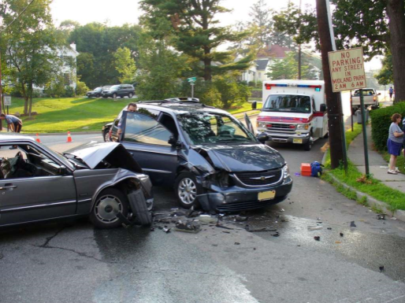
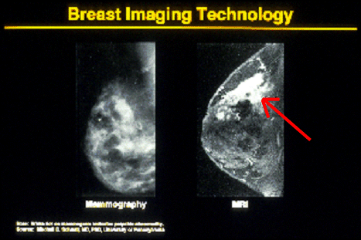
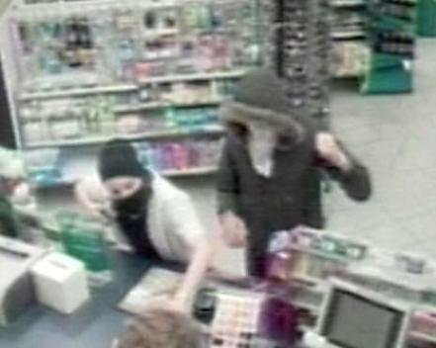
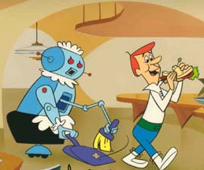
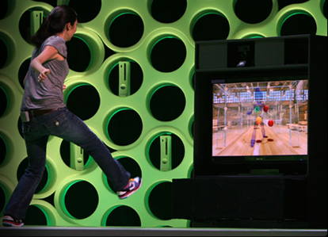
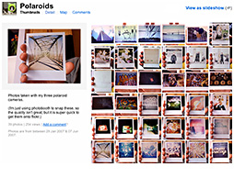
Why computer vision matters
Safety
Health
Security
Comfort
Fun
Access

Slide 11
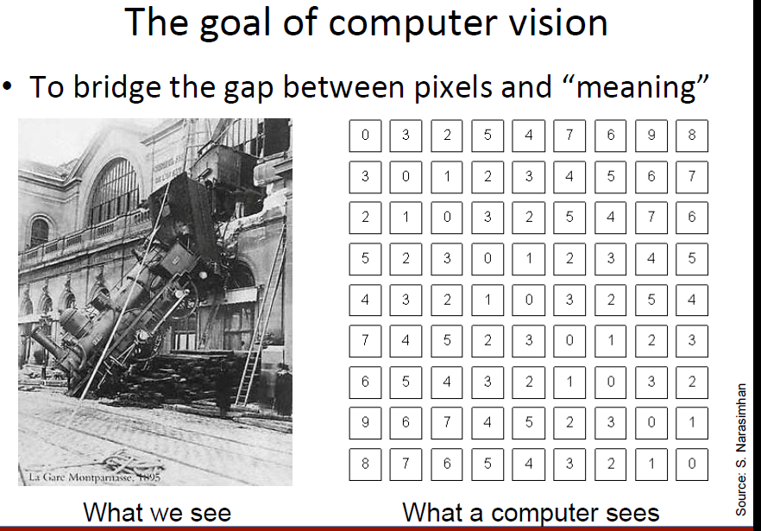
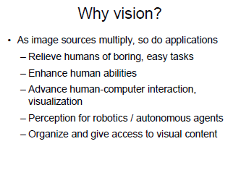

Slide 12
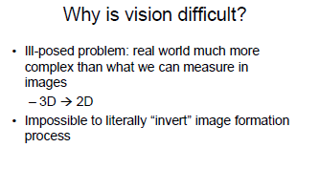

Slide 13
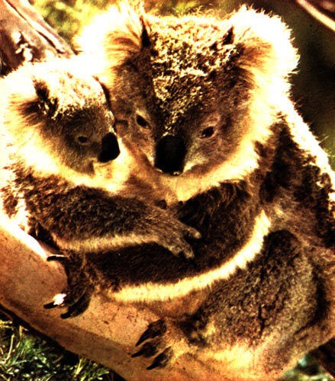
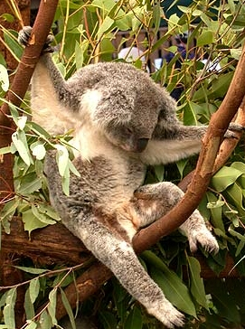
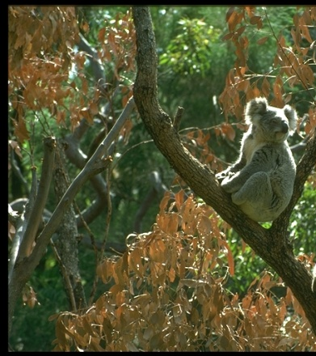
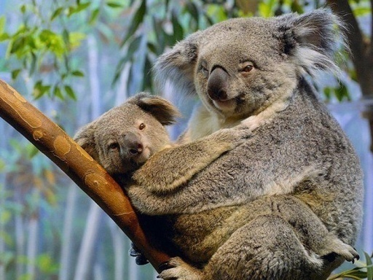
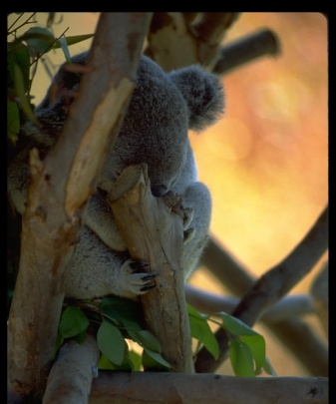
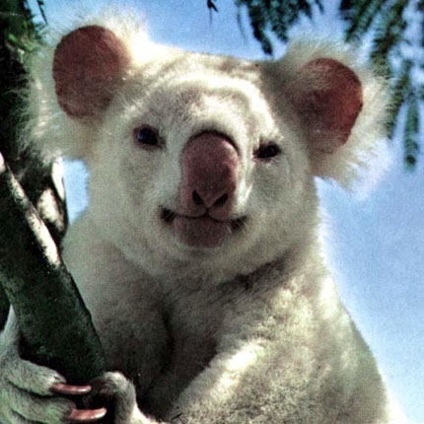
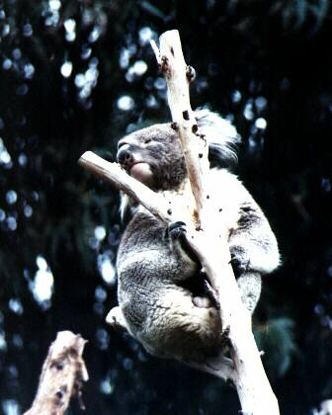
Challenges: many nuisance parameters
Illumination
Object pose
Clutter
Occlusions
Intra-class appearance
Viewpoint
K. Grauman, B. Leibe

Slide 14
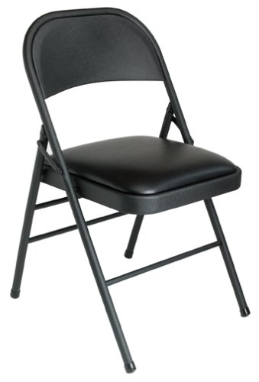
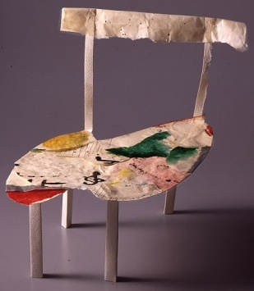
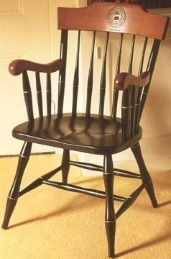
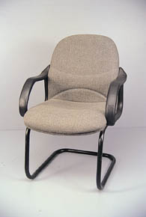
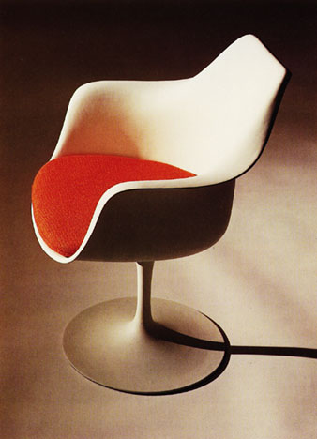
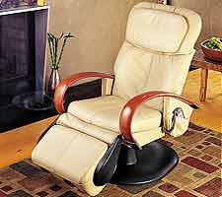
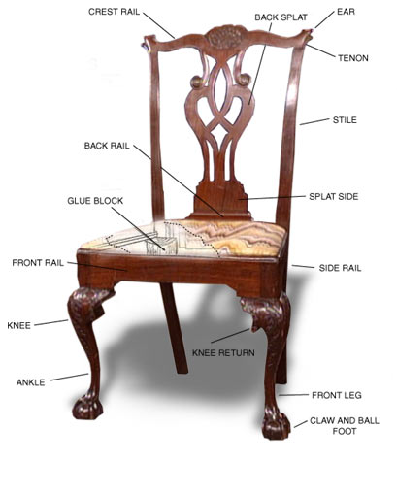
Challenge: intra-class variation
Functional Categories
e.g. chairs = “something you can sit on”

Slide 15
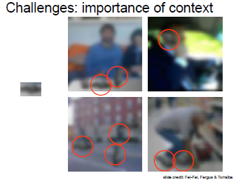

Slide 16
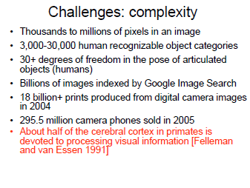

Slide 17
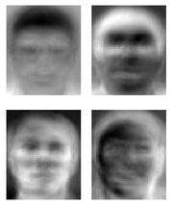
Ridiculously brief history of computer vision
1966: Minsky assigns computer vision as an undergrad summer project
1960’s: interpretation of synthetic worlds
1970’s: some progress on interpreting selected images
1980’s: ANNs come and go; shift toward geometry and increased mathematical rigor
1990’s: face recognition; statistical analysis in vogue
2000’s: broader recognition; large annotated datasets available; video processing starts
2030’s: robot uprising?
Guzman ‘68
Ohta Kanade ‘78
Turk and Pentland ‘91

Slide 18
How vision is used now
Examples of state-of-the-art
https://www.ted.com/talks/fei_fei_li_how_we_re_teaching_computers_to_understand_pictures?language=zh-cn（李飞飞TED视频）
Some of the following slides by Steve Seitz

Slide 19
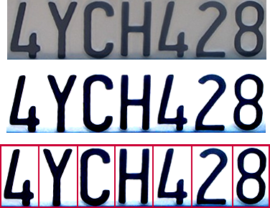
Optical character recognition (OCR)
Technology to convert scanned docs to text
If you have a scanner, it probably came with OCR software
Digit recognition, AT&T labs
http://www.research.att.com/~yann/
License plate readers
http://en.wikipedia.org/wiki/Automatic_number_plate_recognition

Slide 20
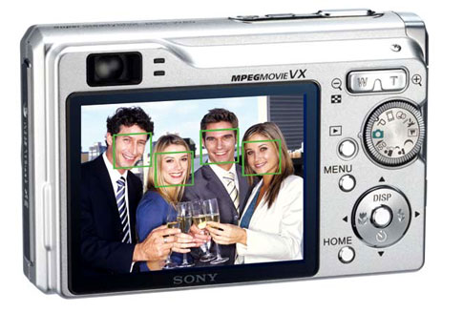
Face detection
Many new digital cameras now detect faces
Canon, Sony, Fuji, …
Notes:
Why would this be useful? Main reason is focus. Also enables “smart” cropping.

Slide 21
Smile detection
Sony Cyber-shot® T70 Digital Still Camera

Slide 22
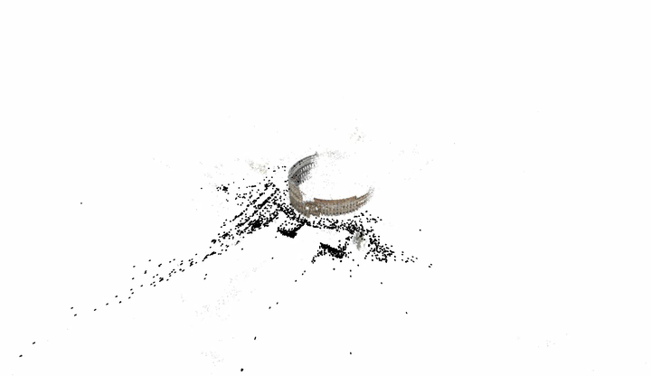
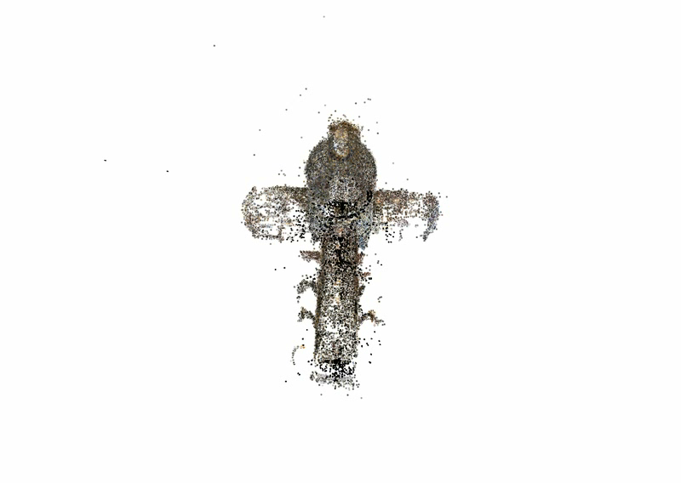
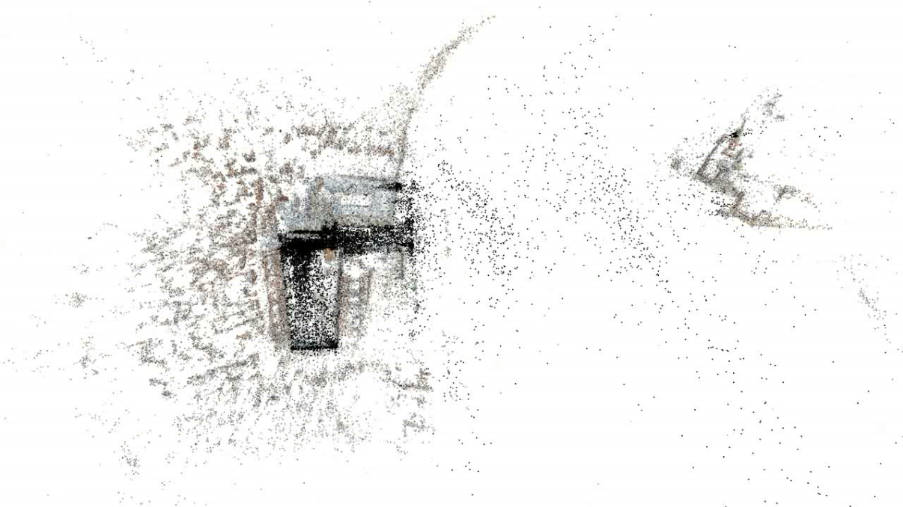
3D from thousands of images
Building Rome in a Day: Agarwal et al. 2009

Slide 23
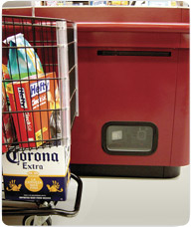
Object recognition (in supermarkets)
LaneHawk by EvolutionRobotics
“A smart camera is flush-mounted in the checkout lane, continuously watching for items. When an item is detected and recognized, the cashier verifies the quantity of items that were found under the basket, and continues to close the transaction. The item can remain under the basket, and with LaneHawk,you are assured to get paid for it… “

Slide 24
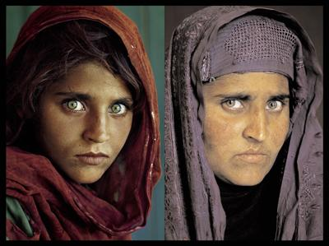
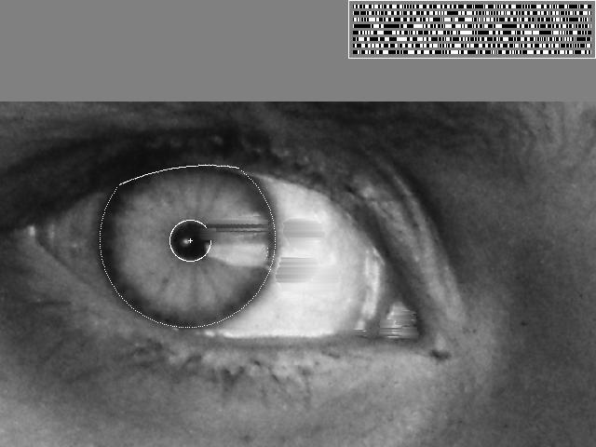
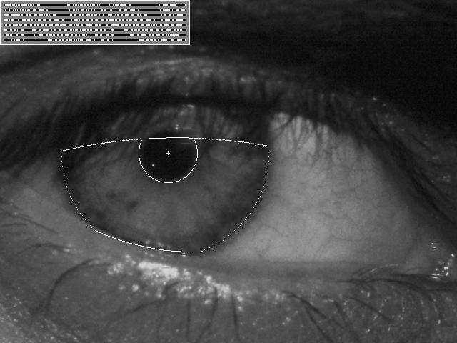
Vision-based biometrics
“How the Afghan Girl was Identified by Her Iris Patterns” Read the story
wikipedia
Notes:
Age 12, Age 30

Slide 25
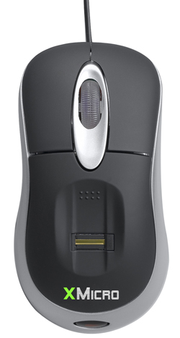
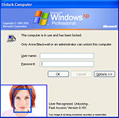

Login without a password…
Fingerprint scanners on many new laptops, other devices
Face recognition systems now beginning to appear more widely http://www.sensiblevision.com/

Slide 26
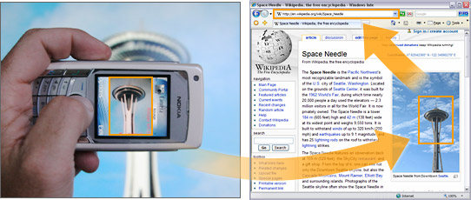
Object recognition (in mobile phones)
Point & Find, Nokia
Google Goggles
http://v.youku.com/v_show/id_XMTI2MzMxOTk0NA==.html

Slide 27
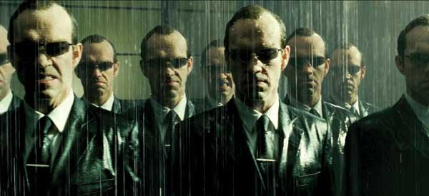
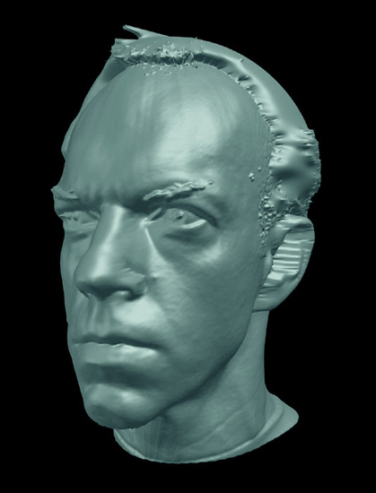
Special effects: shape capture
The Matrix movies, ESC Entertainment, XYZRGB, NRC

Slide 28


Special effects: motion capture
Pirates of the Carribean, Industrial Light and Magic

Slide 29

Sports
Sportvision first down line
Nice explanation on www.howstuffworks.com
http://www.sportvision.com/video.html

Slide 30

Smart cars
Slide content courtesy of Amnon Shashua
Mobileye
Vision systems currently in high-end BMW, GM, Volvo models
By 2010: 70% of car manufacturers.

Slide 31

Google cars
Oct 9, 2010. "Google Cars Drive Themselves, in Traffic". The New York Times. John Markoff
June 24, 2011. "Nevada state law paves the way for driverless cars". Financial Post. Christine Dobby
Aug 9, 2011, "Human error blamed after Google's driverless car sparks five-vehicle crash". The Star (Toronto)

Slide 32


Interactive Games: Kinect
Object Recognition: http://www.youtube.com/watch?feature=iv&v=fQ59dXOo63o
Mario: http://www.youtube.com/watch?v=8CTJL5lUjHg
3D: http://www.youtube.com/watch?v=7QrnwoO1-8A
Robot: http://www.youtube.com/watch?v=w8BmgtMKFbY

Slide 33

Vision in space
NASA'S Mars Exploration Rover Spirit captured this westward view from atop a low plateau where Spirit spent the closing months of 2007.
Vision systems (JPL) used for several tasks
Panorama stitching
3D terrain modeling
Obstacle detection, position tracking
For more, read “Computer Vision on Mars” by Matthies et al.

Slide 34


Industrial robots
Vision-guided robots position nut runners on wheels

Slide 35



Mobile robots
NASA’s Mars Spirit Rover
http://en.wikipedia.org/wiki/Spirit_rover
http://www.robocup.org/
Saxena et al. 2008
STAIR at Stanford

Slide 36


Medical imaging
3D imaging
MRI, CT
Image guided surgery
Grimson et al., MIT

Slide 37
Computer Vision and Nearby Fields
Computer Graphics: Models to Images
Comp. Photography: Images to Images
Computer Vision: Images to Models

Slide 38
Computer Vision and Nearby Fields
Derogatory summary of computer vision:
“Machine learning applied to visual data.”
Question answering
Real world
Digital world
Images, videos,
sensor data…
Images, videos,
interaction
Model of the world
Computer Vision
Computer Graphics
JH

Slide 39
Computer Vision
Robotics
Machine Learning
Human Computer Interaction
Image Processing Feature Matching Recognition
Graphics
Medical Imaging
Computational Photography
Neuroscience
Optics

Slide 40
Course Topics
Interpreting Intensities
What determines the brightness and color of a pixel?
How can we use image filters to extract meaningful information from the image?
Subspace learning
PCA, LDA
Correspondence and Alignment
How can we find corresponding points in objects or scenes?
How can we estimate the transformation between them?
Categorization and Object Recognition
How can we represent images and categorize them?
-- How can we recognize categories of objects?
Deep Learning
Grouping and Segmentation
How can we group pixels into meaningful regions?

Slide 41

Textbook
http://szeliski.org/Book/

Slide 42
Prerequisites
Linear algebra, basic calculus, and probability
Experience with image processing or Matlab will help but is not necessary

Slide 43
Projects
Face verification(competition)
Face recognition
Image Filtering and Hybrid Images
Local Feature Matching
Scene Recognition with Bag of Words
Object Detection with a Sliding Window

